Slide 1
Adult Skills Fund
Strategic Objectives and Delivery in Lancashire
Market Engagement Event
4 September 2025

Slide 2
Welcome and Introduction
Dr Michele Lawty-Jones

Slide 3
Housekeeping
Fire alarm and meeting point
Facilities
Accessibility Information
Mobile phones

Slide 4
Lancashire Combined County Authority
The creation of the LCCA is a hugely important step as it will see powers currently held by central government passed to decision makers in Lancashire.
It will give local leaders extra powers to tackle key priorities such as better public transport, boosting economic prosperity and improving employment and skills.
The LCCA is also set to address years of historically low investment in the area and provide a platform for accelerated growth.
It will provide a single body for the whole of the county to champion its interests, deliver on local priorities and provide greater local accountability and decision-making powers.
In partnership with business and public service providers, it will give Lancashire a stronger voice on the regional and national stage, ensuring greater benefit from funding and other opportunities.

Slide 5
Devolution: Skills & Employment
The establishment of the Lancashire Combined County Authority, and the initial devolution deal provides opportunity for devolved funds and powers
Opportunity to better align skills and employment programmes with local labour market needs
In the first instance:
  Devolution of the Adult Skills Fund (Dept for Education) – preparation underway, delivery from August 2026
  Joint sign off and ownership of the Local Skills Improvement Plan with the Employer Related Body (Chambers of Commerce) working with Skills England (Dept for Education)
  Devolution of employment funds (Dept for Work & Pensions) – Connect to Work in the first instance
  Joint work with Defence Agencies and Dept for Science, Innovation and Tech re: driving up digital, tech and cyber skills
Opportunity to build on the initial devolution deal, initially through the production of Get Britain Working Plans at a local level

Slide 6
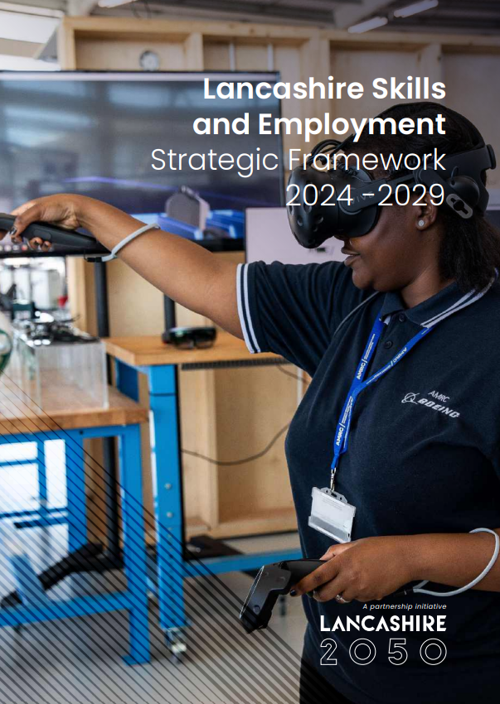

Lancashire Skills and Employment Strategic Framework
2024-2029
The Lancashire Skills and Employment Strategic Framework
2024-2029:
builds on previous iterations and is underpinned by a robust evidence base.
developed in consultation with stakeholders, including employers, schools, colleges, universities, independent training providers and the third sector and aligned with Lancashire 2050 and the LCCA
articulates the skills and employment priorities for Lancashire and is structured into four key themes: Future Workforce, Inclusive Workforce, Skilled and Productive Workforce and Social Value
SG-LancsSkillsEmploymentStratFramewkPRINT-compressed.pdf

Slide 7

Get Lancashire Working
Contribute to the national target of achieving an 80% employment rate by 2035, by increasing the average employment rate across Lancashire and closing the gap in disadvantaged communities
  Drive inclusive access to employment, targeting individuals facing barriers such as health, disability or other socio-economic disadvantages
  Stabilise and stem the flow of the rise in economic inactivity
  Improve the integration of work, health and skills provision, and with the Voluntary, Community, Faith and Social Enterprise Sector (VCFSE)
  Take an evidence-based approach to targeting activity
Delivery targeted towards Priority Cohorts:
  Economically inactive (including Universal Credit (UC) No Work Requirements)
  Young Adults and Young People who are NEET
  Female carers
  People with hidden disabilities
  Those at risk of long-term sickness

Slide 8
Devolution: Adult Skills Fund
The full devolution of the Adult Skills Fund (ASF) from academic year 2026/27 was confirmed as a core element of Lancashire’s devolution deal. This gives the LCCA and its partners the chance to better connect labour market need and opportunity via investment in adult skills.
Our opportunity : LCCA now has the tools to:
  Align skills investment with local economic priorities.
  Tackle inequalities in access to learning.
  Drive inclusive growth and productivity.
Our responsibility : To ensure every pound delivers maximum impact for Lancashire’s people and places.
We must be able to demonstrate that LCCA, and its partners, use of devolved ASF delivers better or more tailored outcomes than a centralised approach.

Slide 9
Alignment with Get Lancashire Working
The Get Britain Working White Paper published November 2024 sets out a range of actions to reverse the growth in economic activity and improve employment rates.
ASF Delivery in Lancashire will support its core aims by:
Engaging residents who are economically inactivity, especially among those with health conditions or caring responsibilities.
Supporting young adults who are unemployed or economically inactive through targeted skills provision.
Improving basic skills for adults lacking essential literacy, numeracy, and digital capabilities.
Joining up of work, health, and skills provision, working collaboratively with the NHS Lancashire and Cumbria Integrated Care Board, Jobcentre Plus and other partners.
ASF-funded programmes will contribute to the White Paper’s ambition of achieving an 80% employment rate by helping more residents access secure, well-paid jobs and progress in their careers.

Slide 10
Lancashire Strategic Skills Plan Overview
Ashley Wells

Slide 11

Development of Lancashire’s Strategic Skills Plan
A steering group oversaw the development of the plan which included the three upper tier local authorities, representatives from the Lancashire College Group, a representative from the Chamber of Commerce (responsible for the Lancashire LSIP) and Lancashire Work Based Learning Forum. In addition, over thirty interviews were undertaken with a wide range of stakeholders including district councils, colleges, independent training providers, third sector providers and employers.
Approved by LCCA on 24 April 2025.
Submitted to DfE as part of our self assessment against readiness conditions on 23 May 2025.
Will be published on Lancashire Skills Hub website (www.lancashireskillshub.co.uk)
Appendix+A.pdf

Slide 12
Strategic Foundations
The Strategic Skills Plan will guide the commissioning of devolved ASF in Lancashire, aligning investment with both local and national priorities.
Industrial Strategy and Skills England priorities
Developing talent pipelines for high-growth sectors such as clean energy, AI, life sciences, and advanced manufacturing, addressing vocational and technical skill shortages, and embedding lifelong learning and adult retraining to meet the evolving demands of the economy.
Lancashire Growth Plan: Growth Sectors​
The Lancashire Growth Plan targets national security and resilience, clean growth and nuclear, digital and AI, advanced engineering and manufacturing, culture and tourism.
Local Skills Improvement Plan (LSIP)
Sets out employer-led priorities for skills development ensuring ASF delivery responds to current and future workforce needs.
Adult Skills Fund Impact​
ASF integrates local and national strategies to enable impactful adult skills development and economic prosperity.

Slide 13
Commissioning Approach
Plan-led
Grant Funded
Providers will likely be required to enter into three-year delivery agreements that set out how their provision will be progressively aligned with Lancashire’s strategic priorities and how they will better support learner progression.
These agreement will be refreshed annually and must be developed in consultation with relevant stakeholders (e.g., District Councils). Each agreement will include a clear statement on how the provider will work collaboratively with Local Authorities and other key partners to deliver more joined-up targeted activity.
Focused Procurement
Contract for Services
Providers commissioned through focused procurement will enter into contractual agreements that clearly define the scope, outcomes and delivery expectations.
We will likely establish an open framework that providers must successfully join to be eligible for tender opportunities.
Once on the framework, providers will be invited to participate in call-off competitions aligned to the priorities.
A Community Grants programme is under consideration to enable smaller organisations to continue supporting adults in hard-to-reach communities.

Slide 14



Key Themes
Re-engagement of 19-24s
Pathways to Higher Technical Qualifications
Tailored Learning
ESOL, English, maths and digital skills
Addressing Economic Inactivity
In-work progression
Sector Work-Based Academies
Skills for priority occupations

Slide 15

Re-Engaging Young Adults in Learning and Work
Young adults who remain outside education or work for extended periods are at higher risk of long-term unemployment, poor health and social exclusion.
Skills gained at this age can shape entire careers offering a high economic return on investment.
We know both the population growth for this cohort and an increasing number of individuals classified as NEET (18+).
Across Lancashire, in December 2024, there were a total of 20800 economically inactive 20–24-year-olds of which only 822 individuals accessed ASF in AY 23/24 an engagement % of less than 4%.
Additionally, there is a large variance in district level engagement with ASF for unemployed 19-24-year-olds from 16.7% to 43.5%.

Slide 16

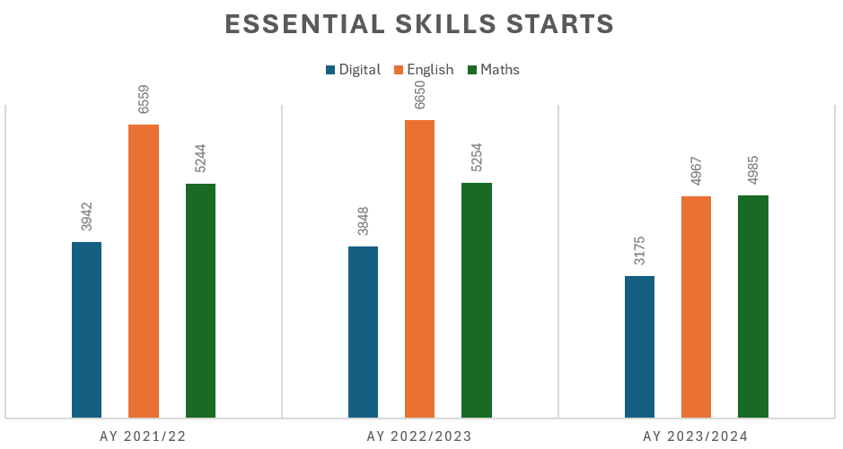
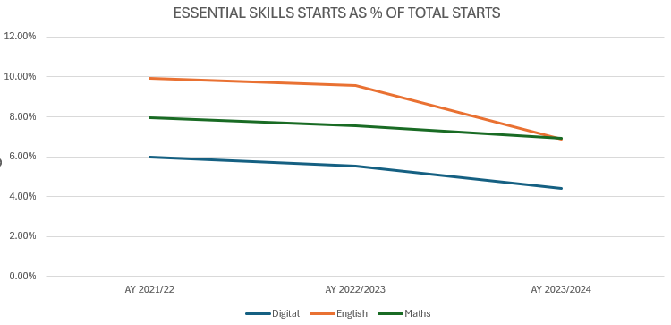
Essential Skills
Overall essential skills starts have shown a consistent downward trend since 2021/22. English starts rose slightly from 6559 to 6650 from AY 21/22 to AY 22/23 followed by a sharp drop to 4967 in AY 23/24.
Maths and Digital starts followed a similar trend with starts across AY 21/22 and AY 22/23 being broadly the same followed by a drop in AY 23/24.
These trends remain when looking at each essential skills starts as a % of total starts across the AY.

Slide 17
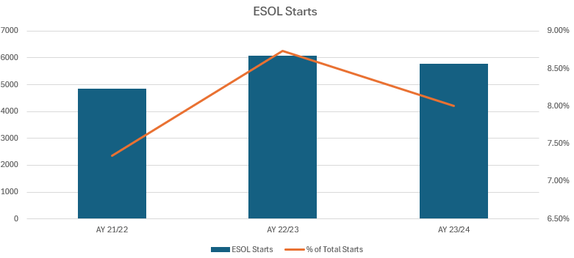
ESOL
In contrast, ESOL starts, whilst slightly down from their AY 22/23 peak however remain higher than in AY 21/22, suggesting sustained demand.

Slide 18

Preparing Learners for Skills and Growth Demand
Building on Lancashire’s Local Skills Improvement Plan (LSIP) Lancashire’s Strategic Skills Plan (SSP) identifies several skills priorities.
  Digital
  Manufacturing and Engineering
  Health and Social Care
  Construction
  Hospitality, Leisure and Tourism
  Transport and Distribution
  Farming and Agriculture
  International Trade
The draft Lancashire Growth Plan, due to be published in September 2025, focuses on growth priorities in the following sectors – building on Lancashire's strengths: national security and resilience, clean growth and nuclear, digital and AI, advanced engineering and manufacturing, culture and tourism.

Slide 19
Skills for Life and Growth
To support a deeper understanding of current delivery patterns and inform our planning, we have grouped ASF (excluding tailored learning) provision by Sector Subject Area into two thematic areas for analysis:
Skills for Life: Focused on foundational learning that supports re-engagement, inclusion, and progression.
Skills for Growth: Aligned to economic priorities and sector development, supporting progression into employment and higher-level learning.

Slide 20
Skills for Life and Growth
Skills for Life
SSA Tier 1
Information and Communication Technology
Languages, Literature and Culture
Preparation for Life and Work
Science and Mathematics
Skills for Growth
SSA Tier 1
Agriculture, Horticulture and Animal Care
Arts, Media and Publishing
Business, Administration and Law
Construction, Planning and the Built Environment
Education and Training
Engineering and Manufacturing Technologies
Health, Public Services and Care
History, Philosophy and Theology
Leisure, Travel and Tourism
Retail and Commercial Enterprise
Social Sciences

Slide 21
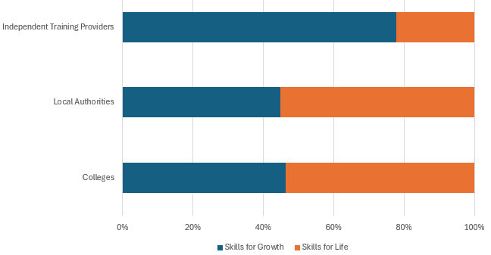
Skills for Life and Growth

Slide 22
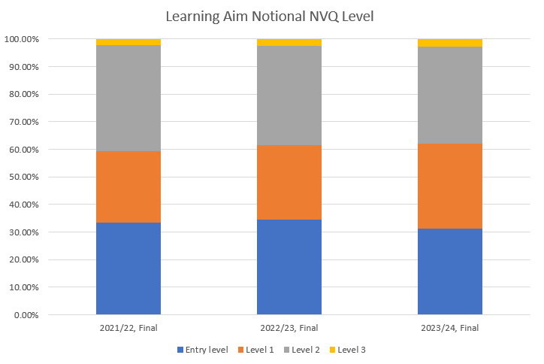
Strengthen Level Three Pathways
Lancashire faces a challenge: fewer adults hold Level 3 qualifications compared to the national average. This reflects missed opportunities in early education and signals a need for targeted investment in upskilling.
While Level 3 starts under the ASF remain low, they’re steadily rising — a positive sign that learners are beginning to move along more advanced pathways.
Level 3 completions aren’t just numbers; they show how ASF is enabling real progress toward future skills needs and help us measure how well those pathways are working.

Slide 23

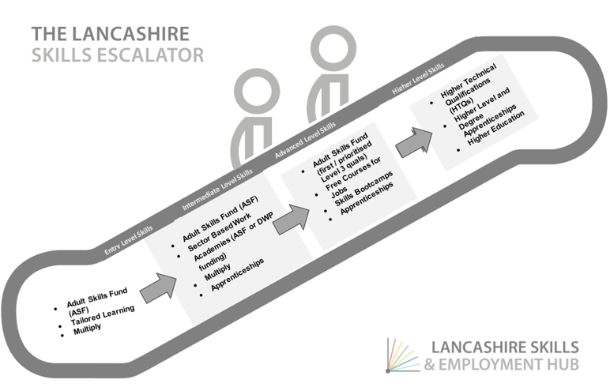
Progression Through Purposeful Pathways
Create clear pathways in, through and beyond ASF learning ensuring ASF plays its pivotal role in the Lancashire’s Skills Escalator, enabling more Lancashire’s residents, regardless of their starting point, to progress towards the opportunities presented by employers.
Referrals both into and from programmes such as Skills Bootcamps and Connect to Work strengthens the learner's journey.
Aligns with the “Get Britain Working” White Paper which emphasises the need for a more coordinated approach between employment services, health systems and skills training.
Get Britain Working White Paper - GOV.UK

Slide 24
Roundtable Exercise: Shaping ASF for Lancashire
One person to capture key points on the flipchart provided
One person to be prepared to feedback verbally to the room
Three questions to consider
Ten minutes per question for discussion
Five minutes for table feedback
Your insights will directly inform how the Adult Skills Fund is shaped and delivered across Lancashire helping us ensure it meets the needs of residents, providers, and the wider economy.

Slide 25
Roundtable Exercises
How should ASF be shaped and aligned to meet the needs of Lancashire’s future workforce?
What would success look like?

Slide 26
Roundtable Exercises
How should ASF be shaped and aligned to support a more inclusive workforce across Lancashire?
What would success look like?

Slide 27
Roundtable Exercises
How should ASF be shaped and aligned to develop a more skilled and productive workforce in Lancashire?
What would success look like?

Slide 28
Next Steps
We will likely establish an open framework that providers must successfully join to be eligible for tender opportunities. Once on the framework, providers will be invited to participate in call-off competitions.
We anticipate establishing the open framework over the autumn with call-off competitions in the new year.
ASF delivery will commence from August 2026.
Only providers who are successful in gaining a position on the framework will be given to opportunity to tender for ASF

Slide 29
Q&A

Slide 30


Skills Bootcamps – Market Engagement Event
4th September 2025

Slide 31
Welcome and Introduction
Dr Michele Lawty-Jones

Slide 32
Aims of Engagement Event
Provide an overview of Skills Bootcamps
Update on Policy context and timeline
Discuss the strategic priorities for Lancashire
Review LMI – Routeways to employment
Explain what devolution means for providers – Framework

Slide 33
Lancashire Combined County Authority
The creation of the LCCA is a hugely important step as it will see powers currently held by central government passed to decision makers in Lancashire.
It will give local leaders extra powers to tackle key priorities such as better public transport, boosting economic prosperity and improving employment and skills.
The LCCA is also set to address years of historically low investment in the area and provide a platform for accelerated growth.
It will provide a single body for the whole of the county to champion its interests, deliver on local priorities and provide greater local accountability and decision-making powers.
In partnership with business and public service providers, it will give Lancashire a stronger voice on the regional and national stage, ensuring greater benefit from funding and other opportunities.

Slide 34
Devolution: Skills & Employment
The establishment of the Lancashire Combined County Authority, and the initial devolution deal provides opportunity for devolved funds and powers
Opportunity to better align skills and employment programmes with local labour market needs
In the first instance:
  Devolution of the Adult Skills Fund (Dept for Education) – preparation underway, delivery from August 2026
  Joint sign off and ownership of the Local Skills Improvement Plan with the Employer Related Body (Chambers of Commerce) working with Skills England (Dept for Education)
  Devolution of employment funds (Dept for Work & Pensions) – Connect to Work in the first instance
  Joint work with Defence Agencies and Dept for Science, Innovation and Tech re: driving up digital, tech and cyber skills
Opportunity to build on the initial devolution deal, initially through the production of Get Britain Working Plans at a local level

Slide 35
Lancashire Skills and Employment Strategic Framework
2024-2029
The Lancashire Skills and Employment Strategic Framework
2024-2029:
builds on previous iterations and is underpinned by a robust evidence base.
developed in consultation with stakeholders, including employers, schools, colleges, universities, independent training providers and the third sector and aligned with Lancashire 2050 and the LCCA
articulates the skills and employment priorities for Lancashire and is structured into four key themes: Future Workforce, Inclusive Workforce, Skilled and Productive Workforce and Social Value
SG-LancsSkillsEmploymentStratFramewkPRINT-compressed.pdf

Slide 36
Get Lancashire Working
Contribute to the national target of achieving an 80% employment rate by 2035, by increasing the average employment rate across Lancashire and closing the gap in disadvantaged communities
  Drive inclusive access to employment, targeting individuals facing barriers such as health, disability or other socio-economic disadvantages
  Stabilise and stem the flow of the rise in economic inactivity
  Improve the integration of work, health and skills provision, and with the Voluntary, Community, Faith and Social Enterprise Sector (VCFSE)
  Take an evidence-based approach to targeting activity
Delivery targeted towards Priority Cohorts:
  Economically inactive (including Universal Credit (UC) No Work Requirements)
  Young Adults and Young People who are NEET
  Female carers
  People with hidden disabilities
  Those at risk of long-term sickness

Slide 37
Lancashire Skills Bootcamps Overview
Mark Spanner

Slide 38
Strategic Priorities - Skills Bootcamps
Must aim to support young adults through accelerated pathways to Apprenticeship and employment opportunities
Must aim to support Lancashire businesses and resident, help to reduce hard to fill vacancies and support employability
Must be co-designed and delivered by employers to support the upskilling of their workforce
Must support the skills gaps identified in the Growth Plan/LSIP and align with the Get Lancashire Working Plan

Slide 39
What are Skills Bootcamps?
Intensive, predominantly level 3 – 5 or equivalent training courses. (Construction, and HGV can be level 2)
Up to 16 weeks that are no less than 60 guided learning hours, 100 glh for all digital courses (including Digital Marketing)
To deliver flexible training Skills Bootcamps based on in-demand employer skills needs that can offer accredited or non-accredited Skills Bootcamps.
Enable Lancashire residents (19+) to upskill to gain work, additional responsibilities, or access new opportunities and will offer guaranteed job interviews for unemployed or career-changing participants.
To address the needs of Lancashire employers by delivering targeted interventions to meet short-to-medium-term skills demand to fill vacancies and drive productivity.
Bring Lancashire residents closer to better jobs by helping to fill vacancies and skills gaps (including those currently in employment)

Slide 40
What makes a successful Skills Bootcamp?
“Working collaboratively to meet the skills needs of Lancashire employers and residents”
LANCASHIRE
The Lancashire Skills and Employment Strategic Framework 2024-29
LSIP
Growth Plan
Employer
Engagement
EMPLOYERS
Actively involved in the design of the training
Committed to providing guaranteed interviews
Committed to providing work experience, mentoring and/or further training
LEARNERS
Signposted to Skills Bootcamp via referral routes e.g., JCP/NCS/Restart/ Social Media
Establish commitment, eligibility and capability via Skills Scans
Commit to taking up employment
Self-Employed
Employed requiring upskilling
PROVIDERS
Design and develop programme in conjunction with employers, taking into consideration learners needs
Deliver skills and employability training at appropriate level to meet the need
Source and secure guaranteed interviews for learners
OUTCOMES
Individual secures employment in new job within 6 months
Employer skills gaps filled either through recruitment or upskilling
Self-employed individual gains new skills/work opportunities (must be registered self-employed and produce SMART business plan)

Slide 41
Key Performance Indicators
50% of participants in learning by 30th September.
At least 80% of those who start training to complete the Skills Bootcamp.
100% of relevant participants acquire new skills and are offered a guaranteed interview for a relevant role in Lancashire.
At least 75% of completers gain a positive outcome within 6 months
This can include a job in Lancashire with a new employer or a new role or responsibilities with an existing employer.
At least 75% of self-employed completers secure new contracts.
Completers moving into self-employment must become gainfully self-employed as per the Specification.

Slide 42
Skills Bootcamps – Progress to Date
2018–2020
Fast Track Trailblazer (2018-2020) DCMS, GM & Lancashire leading to DfE Pilot (2019 – 2020) – West Midlands Digital Skills Partnership
2020–2021
Wave 1 (2020-2021)- Greater Manchester with Lancashire and other selected areas
2021–2022
Wave 2 (2021-2022) – National procurement process supported by Lancashire Skills Hub
2022–2023
Wave 3 (2022-2023) – Lancashire-specific Skills Bootcamps £1.2million awarded to 6 providers offering 10 programmes in Digital & Electronics to 373 learners
2023–2024
Wave 4 (2023-2024) – Growth and diversification of Lancashire’s Skills Bootcamp programme, 21 providers offering 31 Skills Bootcamps utilising the £3million awarded for 888 learners
2024–2025
Wave 5 (2024 – 2025) – expanding reach, with £6.4million awarded, which is offering 1714 Lancashire residents Skills Bootcamp programmes with 33 providers offering 52 different courses
2025–2026
Wave 6 (2025 – 2026) – continued growth, £7m awarded, with now 32 providers and 66 Skills Bootcamps

Slide 43
Performance
 | Actual Starts (M1) | Completers (M2) | Outcomes (M3)
Wave 4 | 888 | 664 | 267
% Achievement | 127% | 90% | 55%
Wave 5 | 1,708 | 1,331 | 850
% Achievement | 100% | 91% | 64%
Wave 6 | 256 | 217 | 125
% Achievement | 36% | 85% | 58%

Slide 44
Evaluation Feedback– The Positives
Research commissioned for Wave 4 concluded:
  Skills Bootcamps are established as an important part of the overall mix of skills and training provision in Lancashire.
  Complement and potentially provide a progression route from ASF provision, which has traditionally been targeted at Level 2 and below.
  Majority of learners completed their programme and were positive about the content, quality of teaching and support provided.
  Effectively engaged with people who otherwise might not have had the opportunity to secure training and/or a qualification.
  Enhanced skills, qualifications and increased self-confidence.
  £1.97 of benefits generated for every £1.00 of public money invested, representing ‘medium’ value for money.

Slide 45
Evaluation Feedback– The Challenges
Employer engagement is critical 64% of Wave 5 learners achieved a positive outcome an increase on Wave 4 by 9%.
Outcomes for learners in employment or self employed were above commissioners' expectations however further growth required for those who are unemployed.
The conversion rate for those hoping to secure a new job or apprenticeship was low.
Gaps remain in underrepresented groups both demographic and geographical.

Slide 46
Current Delivery
New learner data application introduced to streamline processes/paperwork and provide data-rich reports.
Curriculum plans regularly checked to ensure they are appropriate for the Skills Bootcamps and meet minimum GLH.
Monthly progress reviews with providers covering KPI achievement, recruitment, staffing, quality, case studies and social value.
Quality assurance visit for each Skills Bootcamps.
Collection of learners’ feedback via survey on completion of the programme, which is fed back to providers, informing future cohort delivery.
Fortnightly bulletins to inform providers on performance, upcoming events and important updates.
Community of Practice fully established, well attended with positive feedback.
Bi-weekly ‘drop-in’ session for delivery partners.

Slide 47
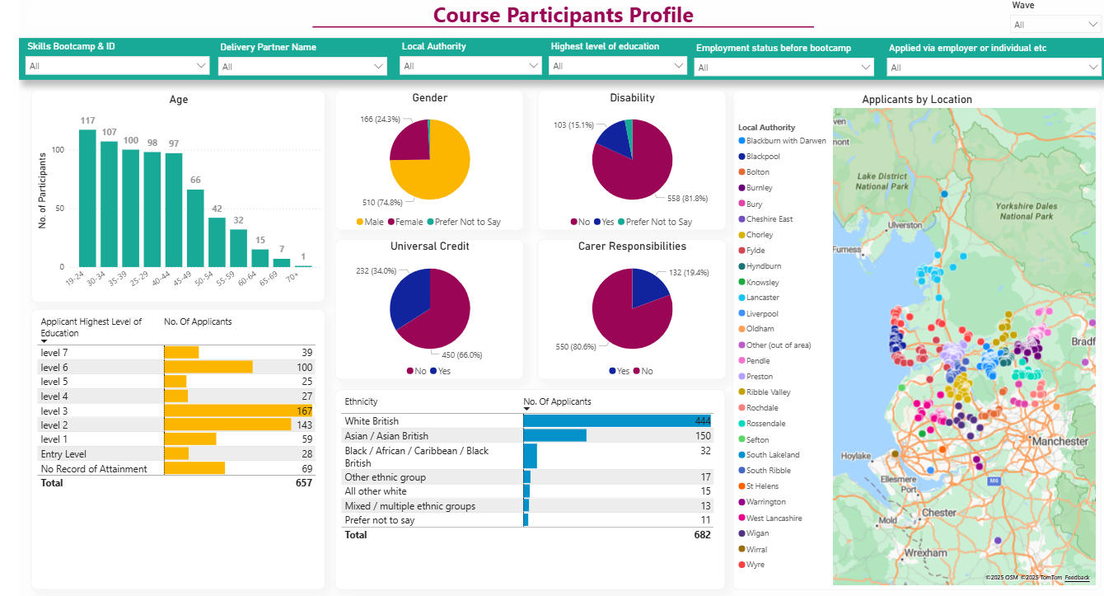
Learner Data Application (LDA)
LDA provides rich dataset which will enable us to consider:
Age
Gender
Disability
Employment Status
Geographical Spread
Pockets of Deprivation

Slide 48
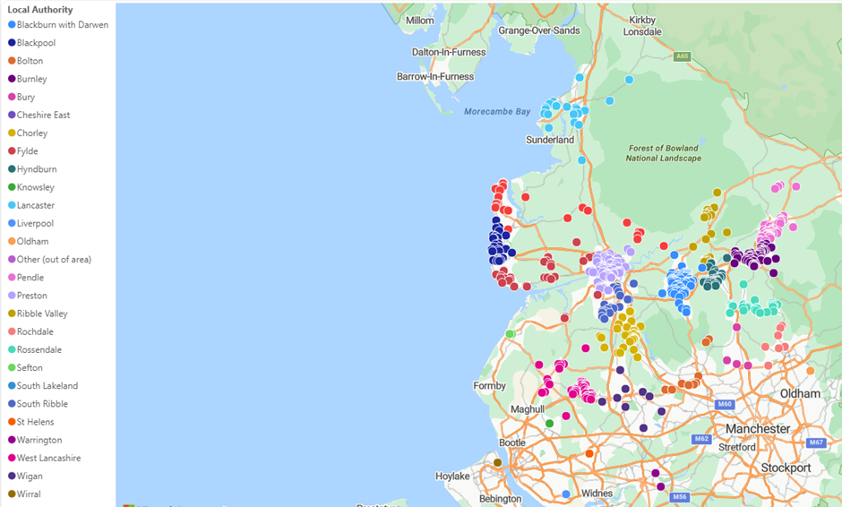
Headline demographics of Wave 6 Learners
34.1% of Learners are in receipt of Universal Credit.
15.1% of Learners identify as having a disability.
14.3% of Learners are at Entry Level or have No Record of Attainment.
1 in 3 Learners are aged between 19-29.
19.4% of Learners have caring responsibilities.
35% of Learners are non “White British”

Slide 49

Focus for Wave 7
Continue to focus on sector specific needs and skills lacking in Lancashire, avoiding duplication of existing provision (ASF).
Collaboration to raise awareness of Skills Bootcamps provision amongst employers and residents, highlighting the benefits.
Focus on demographic inclusion.
Address ‘coldspots’ ensuring all parts of Lancashire are served.
Delivery providers to ensure they are working with a wide range of employers to secure interviews.
Feedback from employers used to ensure employer needs are met.
Feedback from learners to ensure suitable content, design and delivery.

Slide 50
Growth Sectors / LSIP
Local Skills Improvement Plan (LSIP)
Drivers of Growth
• A Strategic Role in National Security and Resilience
• Clean Growth and a Nuclear Renaissance
• Sustainable Digital and Artificial Intelligence
• Advanced Engineering and Manufacturing Excellence
• Culture and Tourism as Economic Catalysts
  Digital
  Manufacturing and Engineering
  Health and Social Care
  Construction
  Hospitality, Leisure and Tourism
  Transport and Distribution
  Farming and Agriculture
  International Trade

Slide 51

Data Dashboard
https://www.lancashireskillshub.co.uk/our-people/evidence-base/

Slide 52
Roundtable Exercise: Shaping Skills Bootcamps for Lancashire
One person to capture key points on the flipchart provided
One person to be prepared to feedback verbally to the room
Two questions to consider
Ten minutes per question for discussion
Five minutes for table feedback
Your insights will directly inform how the Skills Bootcamps is shaped and delivered across Lancashire helping us ensure it meets the needs of residents, providers, and the wider economy.

Slide 53
Roundtable Exercises
What Skills Bootcamps should be considered for Wave 7?

Slide 54
Roundtable Exercises
How can milestone 3 be maximised to support recruitment opportunities?

Slide 55
Next Steps
We will likely establish an open framework that providers must successfully join to be eligible for tender opportunities. Once on the framework, providers will be invited to participate in call-off competitions.
We anticipate establishing the open framework over the autumn with call-off competitions in the new year.
Wave 7 delivery will commence from April 2026.
Only providers who are successful in gaining a position on the framework will be given to opportunity to tender for Wave 7

Slide 56
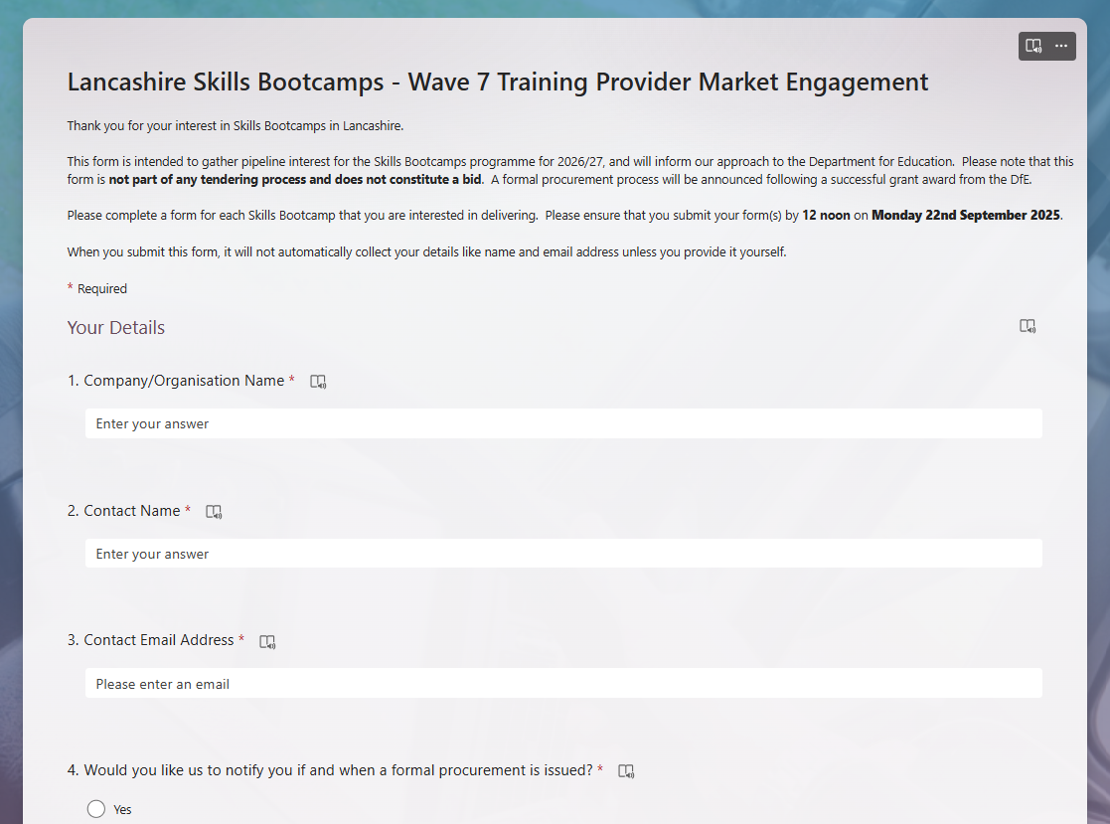
Next Steps – Training Provider
Interested in delivering a Skills Bootcamp?
Please complete a Training Provider Market Engagement Form.
Include evidence of employer demand for your suggested Skills Bootcamp in Lancashire.
Please submit by 12 noon Monday 22nd September 2025 https://forms.office.com/e/Sz0Kgvr550
The Skills & Employment Hub will review all submissions to agree the lot areas for the funding year.
Please note that the Market Engagement Form does not constitute a formal bid. Additional events surrounding the procurement process will follow a successful grant award from the DfE.
Any questions? Please email: LancsSkillsHub@LancashireSkillsHub.co.uk

Slide 57
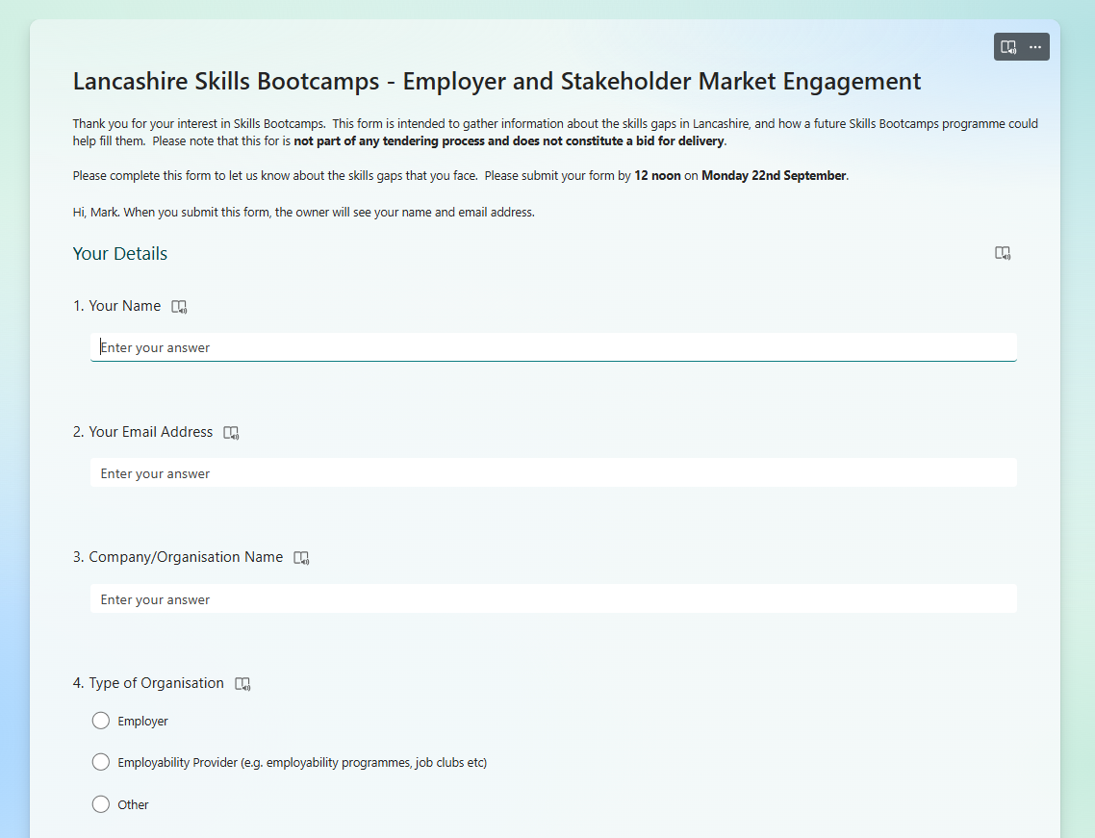
Next Steps – Employers and Stakeholders
Supporting Skills Bootcamps in Lancashire
Please complete the employer and stakeholder market engagement form by 12 noon Monday 13th September 2025.
Include how you would like to be involved in the Skills Bootcamps programme in Lancashire: https://forms.office.com/e/Sz0Kgvr550
Indicate whether you would like your contact details to be shared with our training partners.
Have you signed the Lancashire Skills Pledge? Get recognition for Recruiting Lancashire People and Upskilling Your Workforce Lancashire Skills Pledge - Lancashire Skills and Employment Hub
Any questions? Please email: LancsSkillsHub@LancashireSkillsHub.co.uk

Slide 58
Q&A

