Slide 1




EXPLORE the future of jobs in BlackPOOL, Fylde AND WYRE

Slide 2









EXPLORE the future of jobs in BlackPOOL, Fylde AND WYRE

Slide 3

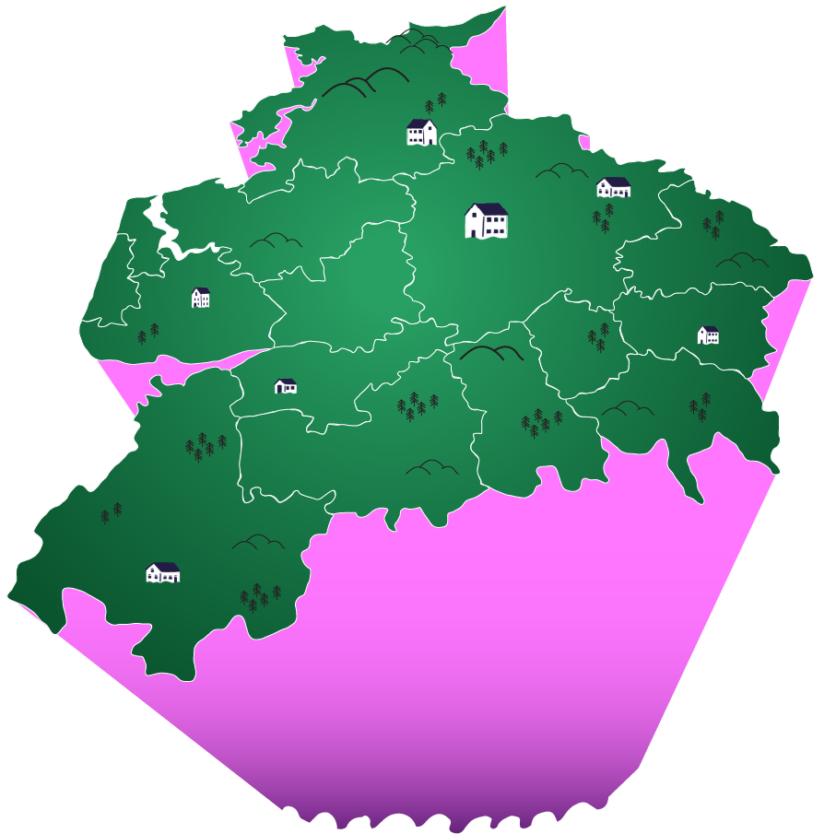









THIS IS LANCASHIRE

Slide 4

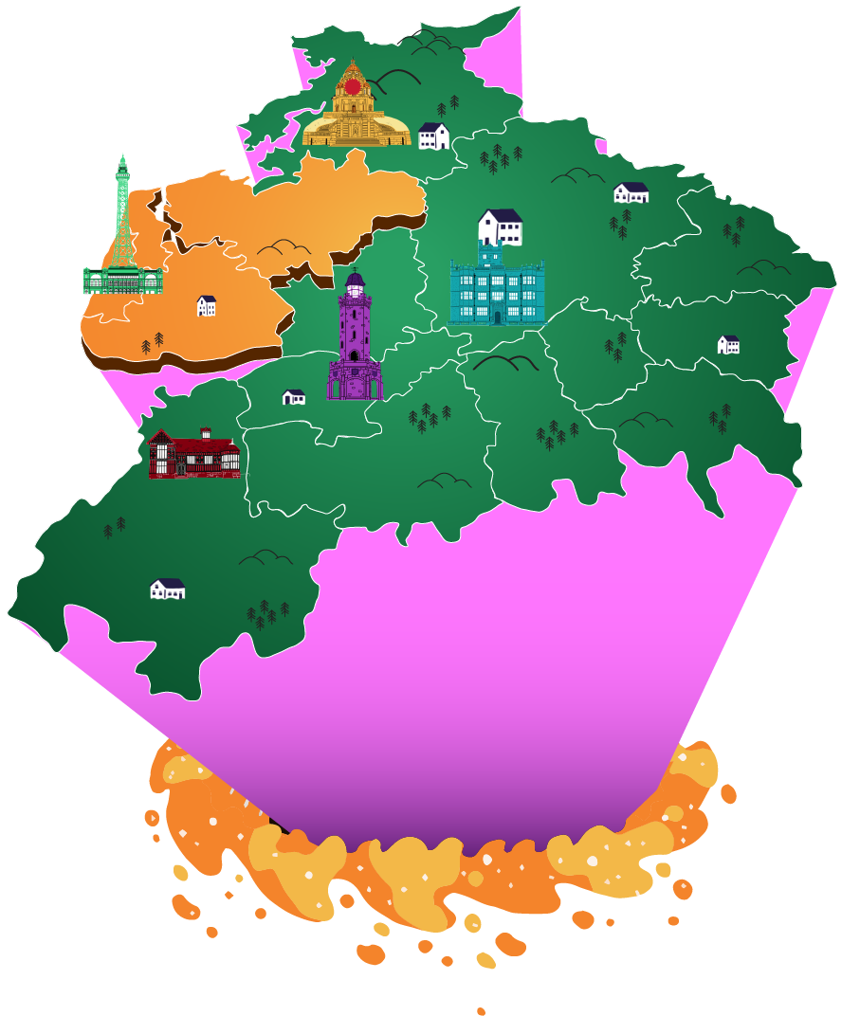


THIS IS YOUR TRAVEL
TO WORK AREA
BlackPOOL, fylde AND WYRE
CATCHY, RIGHT?

Slide 5



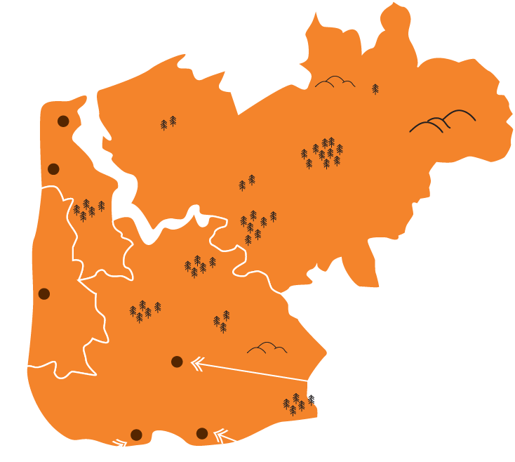


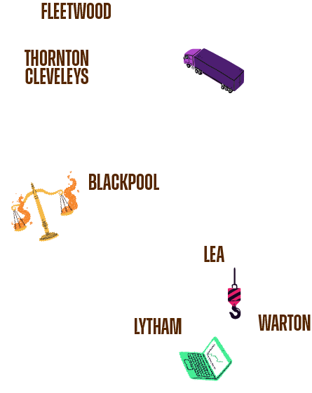

THIS IS BlackPOOL, fylde AND WYRE
83%
OF PEOPLE
WHO LIVE HERE,
WORK HERE
BLACKPOOL
SOUTH SHORE
Manufacturing
FINANCE
WARTON AERODROME

Slide 6



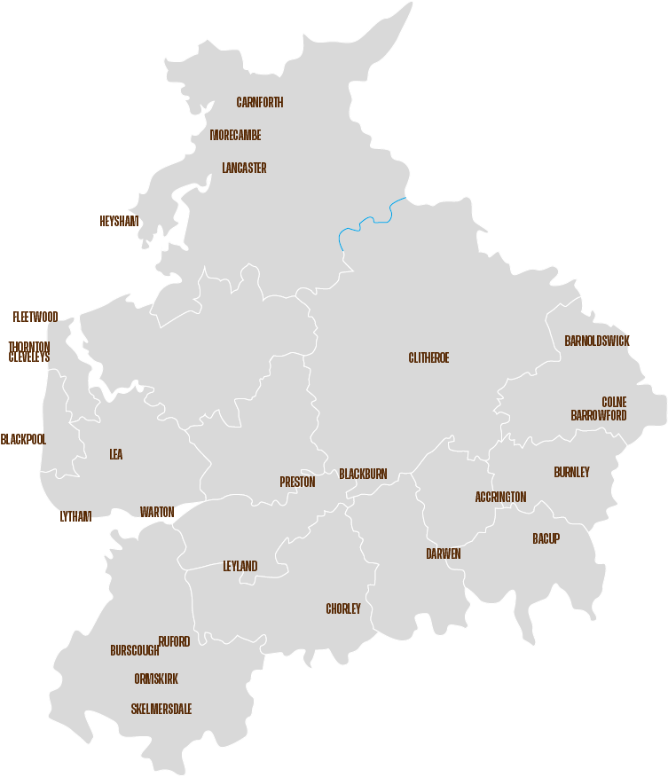



















EMPLOYERS IN LANCASHIRE
advanced manufacturing
food and agriculture
Construction
ENERGY AND LOW CARBON
HEALTH AND SOCIAL CARE
CREATIVE AND DIGITAL
TOURISM AND CULTURE

Slide 7

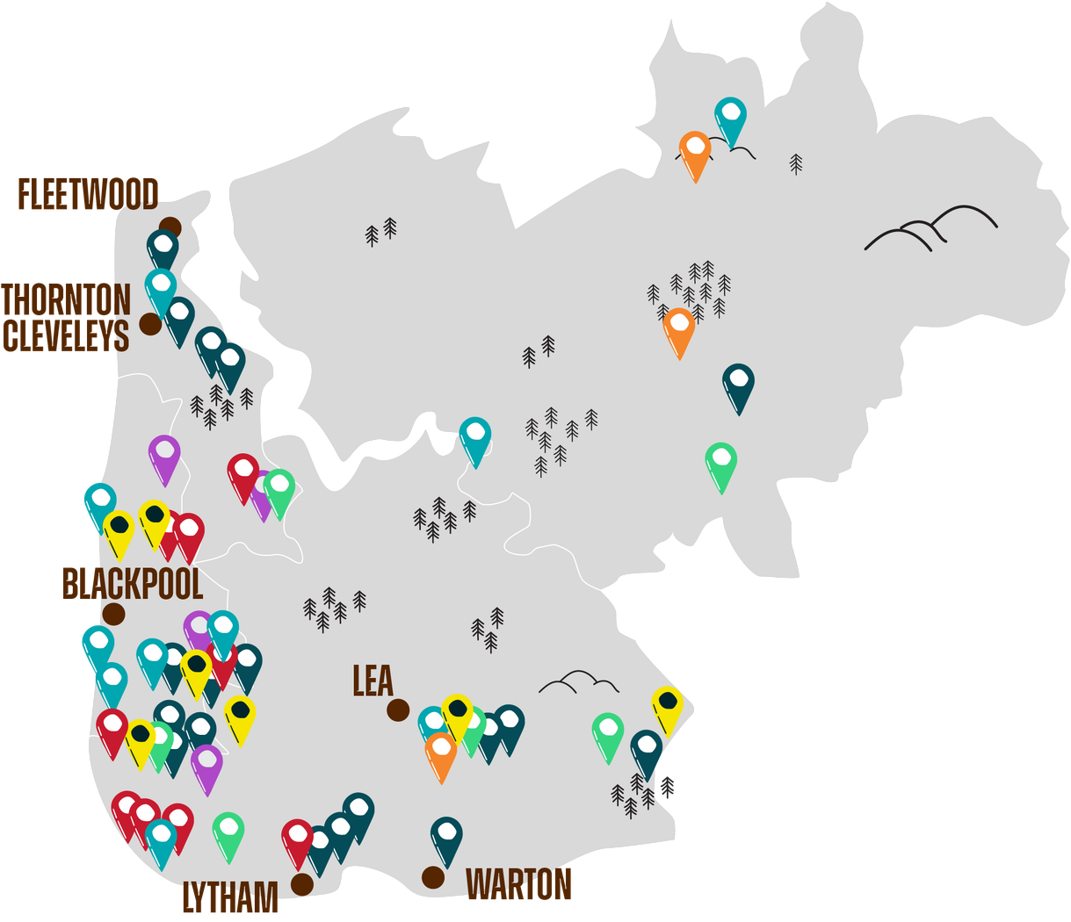






EMPLOYERS IN YOUR AREA
BlackPOOL, fylde AND WYRE
advanced manufacturing
food and agriculture
Construction
ENERGY AND LOW CARBON
HEALTH AND SOCIAL CARE
CREATIVE AND DIGITAL
TOURISM AND CULTURE

Slide 8






EMPLOYMENT SECTORS | BlackPOOL, fylde AND WYRE
TOP 5 JOB TYPES PEOPLE ARE DOING NOW
17%
13%
12%
11%
10%
Manufacturing
HEALTH &
SOCIAL CARE
RETAIL &
WHOLESALE
ACCOMMODATION
& FOOD
Professional,
Scientific & Technical

Slide 9





EMPLOYMENT SECTORS | BlackPOOL, fylde AND WYRE
TOP 5 JOB TYPES PEOPLE WILL BE DOING IN 2034
17%
12%
12%
10%
10%
Manufacturing
HEALTH &
SOCIAL CARE
RETAIL &
WHOLESALE
Professional,
Scientific & Technical
ACCOMMODATION
& FOOD

Slide 10














EMPLOYMENT SECTORS | BlackPOOL, fylde AND WYRE
OTHER JOB TYPES THAT WILL BE AVAILABLE IN 2034
LOW CARBON
TRANSPORT
DIGITAL
FINANCE & LEGAL
STEM

Slide 11


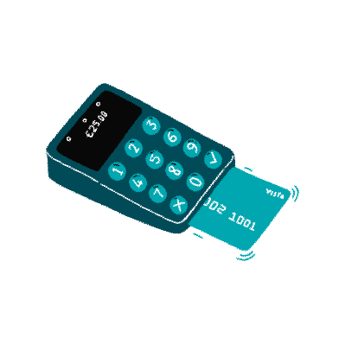









JOB LANDSCAPE IN LANCASHIRE
75.2%
8.3%
ARE IN EMPLOYMENT
OF WHICH SELF EMPLOYED

Slide 12

JOB LANDSCAPE IN YOUR AREA
81.1%
12.9%
ARE IN EMPLOYMENT
OF WHICH SELF EMPLOYED

Slide 13



Apprenticeships
Apprenticeships ARE A GREAT WAY TO EARN AND LEARN WHILST WORKING,
AND available IN AN incrediblY broad RANGE OF JOBS

Slide 14


















WHAT DO WE
MEAN BY
Qualification
LEVELS?
When we talk about qualification
levels, it doesn't just mean
Academic Learning like GCSEs, A
Levels, and Degrees. There are also
equivalent qualification levels in
Technical Education, like
Traineeships, T-Levels and
Apprenticeships.

Slide 15

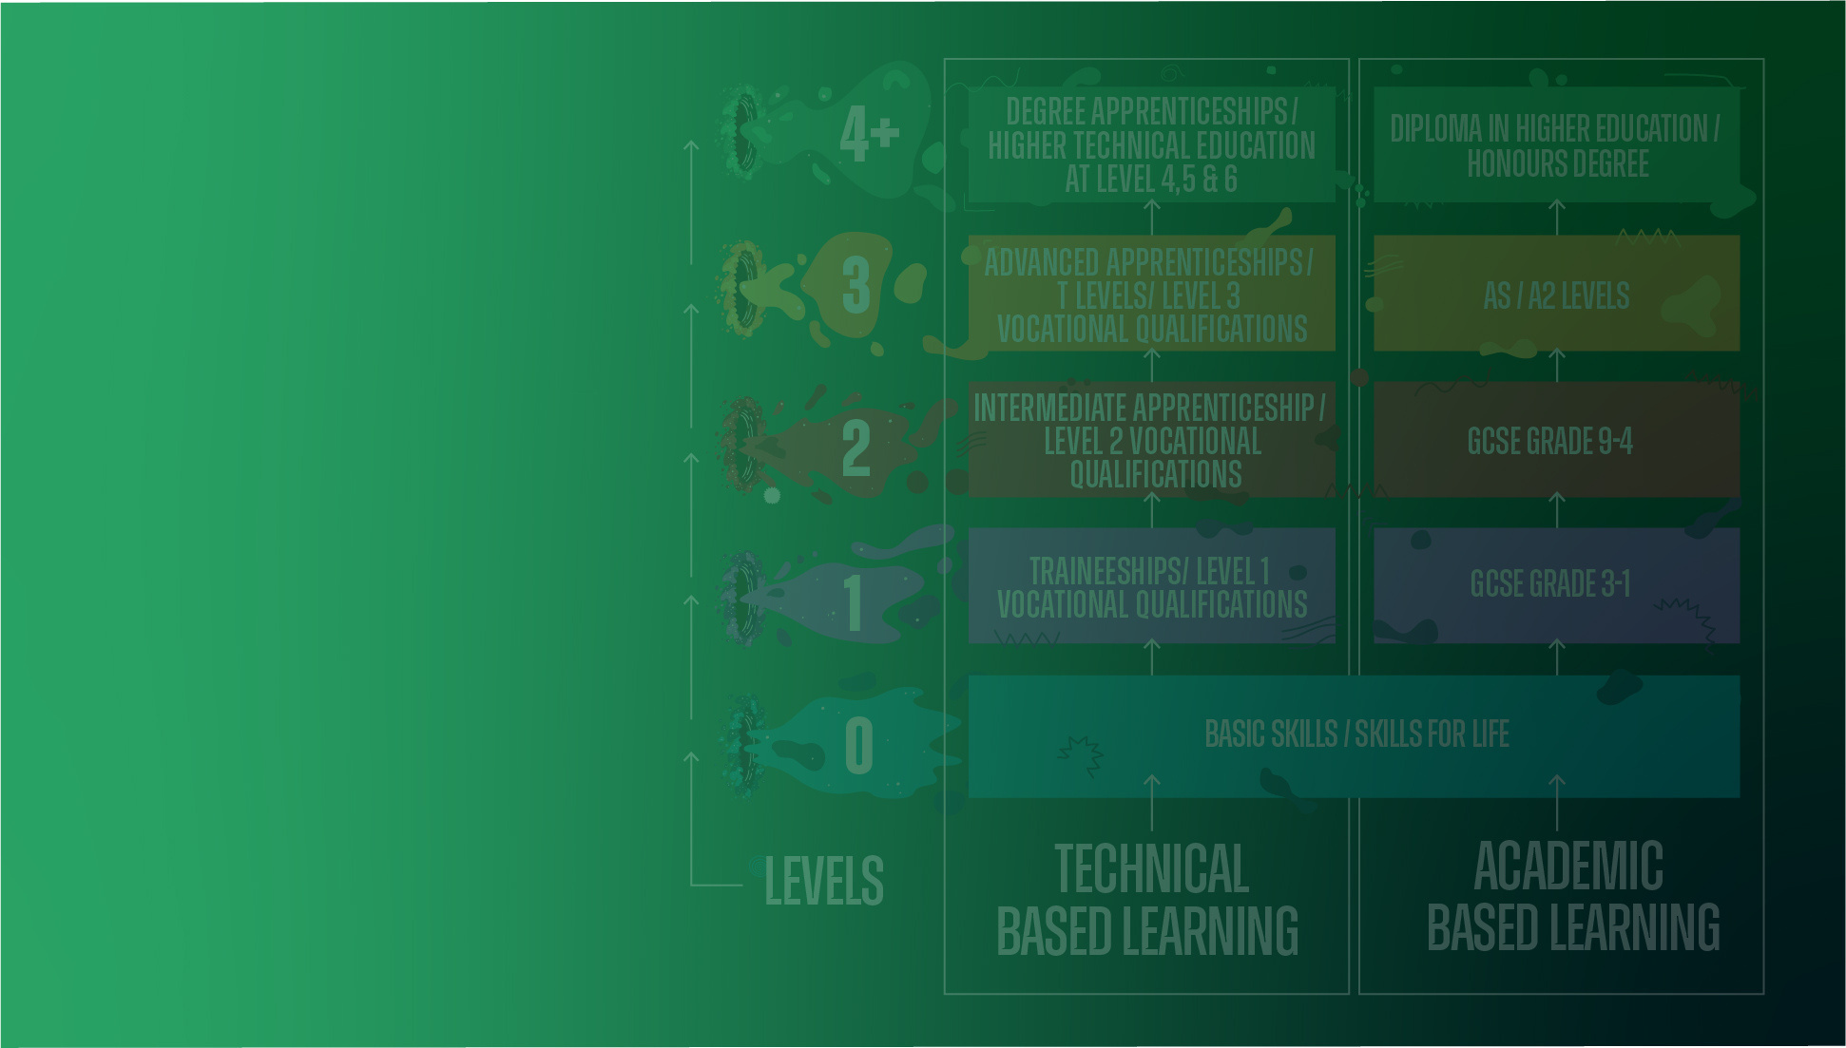





WHAT KIND OF
APPRENTICESHIPS
DO PEOPLE DO
AT LEVEL 2?

Slide 16






WHAT KIND OF
APPRENTICESHIPS
DO PEOPLE DO
AT LEVEL 3?

Slide 17






WHAT KIND OF
APPRENTICESHIPS
DO PEOPLE DO
AT LEVEL 4+?

Slide 18





Apprenticeships
IN THE LAST 4 YEARS, MORE THAN 53,000 PEOPLE STARTED ApprenticeshipS IN LANCASHIRE!
24%
32%
44%
LEVEL 2
LEVEL 3
LEVEL 4

Slide 19













Apprenticeships STARTS (%)
ApprenticeshipS AREN'T JUST FOR YOUNG PEOPLE, PEOPLE OF ALL AGES DO THEM!!
28%
27%
45%

Slide 20




WHAT OTHER JOBS CAN apprenticeS DO?
Engineering
Furniture manufacturer
CHARTERED surveyor
CHEF
PROJECT MANAGER
DIGITAL MARKETER
PLUMBER
AEROSPACE engineer
HEALTH AND SOCIAL CARE
DENTAL NURSE

Slide 21









ITS ALL ABOUT DOING THE
RIGHT qualifications
FOR THE RIGHT JOBS
THAT ARE IN DEMAND IN THE
AREA YOU WANT TO WORK IN...

Slide 22






It is not as simple
as "get as many,
and as high level
qualifications as
possible and you will
get a job and
earn more"

Slide 23







EMPLOYMENT
RATES BY
QUALIFICATION
LEVEL
NO Qualifications
below LEVEL 2
LEVEL 2
HOW LIKELY ARE YOU
TO BE EMPLOYED?
THAT COULD DEPEND
ON YOUR qualifications
LEVEL 3
LEVEL 4+

Slide 24

















THE BETTER THE QUALIFICATIONS,
THE MORE YOU COULD
PotentialLY EARN
NO
Qualifications
LEVEL 2
LEVEL 3
LEVEL
4 AND 5
LEVEL 6+

Slide 25






HOW TO USE YOUR PERSONAL SKILLS
TO BECOME EMPLOYABLE
Positive attitude
Enthusiasm
INTEREST
WORK ETHIC
TIME MANAGEMENT
OrganisatioN

Slide 26




FUTURE
SKILLS & JOBS
Looking forward over the next 10 to 15 years, we can see a
shift in the level of qualifications employers are demanding

Slide 27






FUTURE SKILLS & JOBS
Jobs vs qualifications up to 2034
LEVEL 1
LEVEL 2
LEVEL 3
LEVEL 4

Slide 28








FUTURE SKILLS & JOBS
Jobs vs qualifications up to 2034
LEVEL 1

Slide 29







FUTURE SKILLS & JOBS
Jobs vs qualifications up to 2034
LEVEL 2

Slide 30







FUTURE SKILLS & JOBS
Jobs vs qualifications up to 2034
LEVEL 3

Slide 31







FUTURE SKILLS & JOBS
Jobs vs qualifications up to 2034
LEVEL 4

Slide 32









Slide 33







national
cyber force
COMING TO LANCASHIRE
YOU COULD BE
WORKING ON TOP
SECRET MISSIONS TO
PROTECT THE NATION
2000 jobs
will be created
in lancashire's
national cyber force hq
by 2030
CALLING ALL GAMERS,
INFLUENCERS, HACKERS
& SOCIAL MEDIA EXPERTS -
THERE IS A JOB FOR YOU
WORKING WITH THE
BRIGHTEST MINDS TO MAKE
THE INTERNET SAFE

Slide 34








FUTURE EXCITING opportunities
EDEN PROJECT
TOURISM
EXPECTED TO OPEN IN 2028
750 JOBS
the
EDEN PROJECT
is expected to bring
2000 jobs
to the area
SUPPLY CHAIN
950 JOBS
ECOLOGY
300 JOBS

Slide 35











FUTURE EXCITING opportunities
Green jobs
coming to lancashire
nuclear
By 2034,
Lancashire is
predicted
to have 28,000
green jobs
hydrogen
energy
electric vehicle
Infrastructure
offshore wind

Slide 36
WORLDS OF opportunity - ALL IN Lancashire

